Slide 1
Final Exam
CIS 122
Professor Payal Shete
Hu
Notes:
Hello, every one. Good morning. Today I will introduce my final exam assignment for CIS 122.

Slide 2

The Final Exam
Image1
Image2
F1OUT.JPG
Part1
Part2
subFn1
subFn1
F2OUT.JPG
SubFn2
subFn2
F2OUT.JPG
SubFn3
subFn3
SubFn4
subFn4
Notes:
The final exam has two parts. In the first part we should input two images and get one F1OUT.JPG, then we put F1OUT to part2 and finally get the F2OUT.JPG. Next I will explain each step for my py programs.

Slide 3
Part1
mainFn()
def mainFn(path):
global p1,p2
global w1,h1,w2,h2
global canvas1
global wc1,hc1
p1=makePicture(pickAFile())
w1,h1=getWidth(p1),getHeight(p1)
p2=makePicture(pickAFile())
w2,h2=getWidth(p2),getHeight(p2)
canvas1=makeEmptyPicture(w1+w2+5,h1+h2+5,green)
wc1,hc1=getWidth(canvas1),getHeight(canvas1)
Image1
Image2
Using global variables to save steps
Part1
mainFn()
subFn1
SubFn2
SubFn3
SubFn4
F1OUT.JPG
Notes:
In the main function of part1, I used global variable to save steps. If not, I must repeat to define same variables in each sub function.

Slide 4
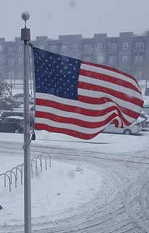

Part1
subFn1
mirroring pixels
mirrorpoint=h1/2 #set mirrorpoint
for x in range(0,w1): #choose original x range
for y in range(0,mirrorpoint): #choose original y range
topPX=getPixel(pic1,x,y) #set the start point of the copied pixels
bottomPX=getPixel(pic1,x,h1-y-1) #set the destination of the copied pixels
colorP=getColor(topPX) #copy color from original pixels
setColor(bottomPX,colorP) #set color to the destination
Image1
Image2
Part1
mainFn()
subFn1
SubFn2
SubFn3
subFn1
SubFn4
F1OUT.JPG
Notes:
Sub Function 1: the method I used is mirroring pixels. We can see codes I wrote, and the effect looks like this.

Slide 5
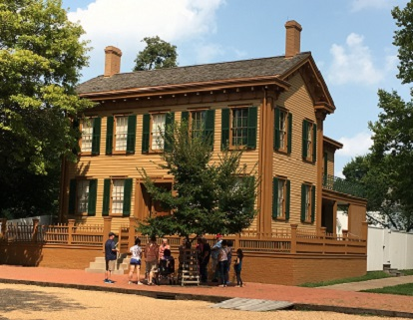
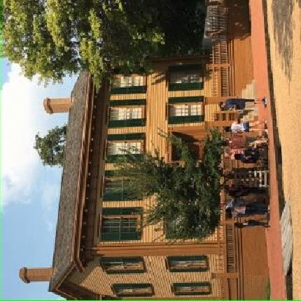
Part1
rotating an image
SubFn2
targetX=0 #set start point on the canvas
for picX in range(0,w2): #loop the X value
targetY=0 #set start ponit on the canvas
for picY in range(0,h2): #loop the Y value
colorC=getColor(getPixel(pic2,picX,picY)) #copy pixels from the picture
setColor(getPixel(pic2r,targetY,targetX),colorC) #write pixels to the canvas
targetY=targetY+1 #move to next Y value
targetX=targetX+1 #move to next X value
Image1
Image2
Part1
mainFn()
subFn1
SubFn2
SubFn3
SubFn2
SubFn4
F1OUT.JPG
Notes:
Sub Function 2: rotating an image. I add annotation to each line of my codes. The effect is this.

Slide 6
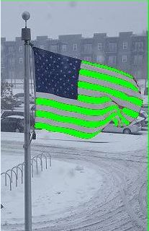
Part1
SubFn3
Changing Color
#red eye reduction algorithm #resource: https://stackoverflow.com/questions/133675/red-eye-reduction-algorithm
gbaverage=(float(g)+float(b))/2
reddect=(float(r))/gbaverage
if picX>44 and picX<200: #choose x range
if picY>63 and picY<200: #choose Y range
if float(reddect)>1.4: #detect red color
setColor(px,green) #change color to green
Image1
Image2
Part1
mainFn()
subFn1
SubFn2
SubFn3
SubFn4
SubFn3
F1OUT.JPG
Notes:
Sub function 3 is very simple. Just changing color. I searched online for some strategies to detect red color more effectively. I also added the web address for it. If you have interesting, you can visit it.

Slide 7
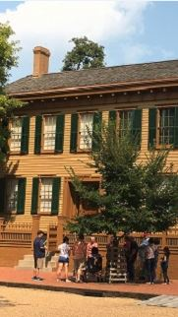
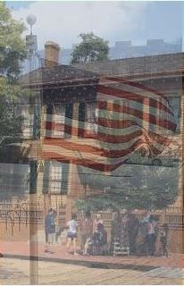
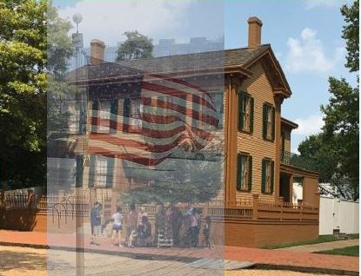
Part1
SubFn4
Blending images
Step1
Step2
Step3
Image1
Image2
Part1
mainFn()
subFn1
SubFn2
SubFn3
SubFn4
F1OUT.JPG
Notes:
Sub function4 has 3 steps. The first step I copy a part of image2 as a new image. In step 2, I blended the new image to image2 to get a blended image. The third step is copying the blended image to image2

Slide 8
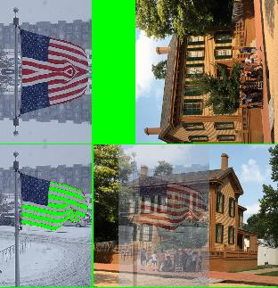
Part1
F1OUT.JPG
subFn1
subFn2
Image1
Image2
Part1
mainFn()
subFn1
SubFn2
SubFn3
SubFn4
SubFn3
SubFn4
F1OUT.JPG
Notes:
The output of part1 is F1OUT.JPG. It looks like this.

Slide 9
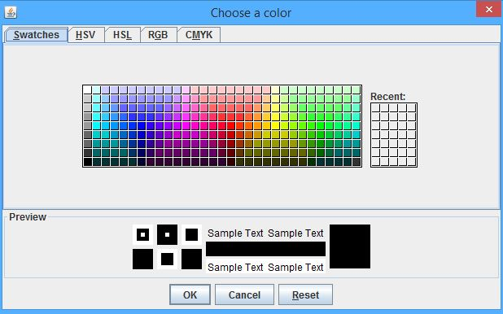
Part2
mainFn()
global f1
global widthf1,heightf1
global canvas2
global widthc,heightc
f1=makePicture(pickAFile())
widthf1,heightf1=getWidth(f1),getHeight(f1)
cc=pickAColor()
widthc,heightc=3*widthf1,3*heightf1
canvas2=makeEmptyPicture(widthc,heightc,cc)
F1OUT.JPG
Part2
mainFn()
subFn1
subFn2
subFn3
subFn4
F2OUT.JPG
Notes:
Now we start to process part2. I used the global variable again and add a function: pickAColor to choose the color of the background of canvas.

Slide 10
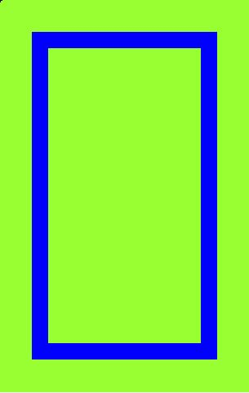
Part2
subFn1
Using classes
t.penDown()
t.drawhor() #use the subclass draw a horizontal line
t.drawver() #use the subclass draw a vertical line
t.drawhor() #use the subclass draw a horizontal line
t.drawver() #use the subclass draw a vertical line
F1OUT.JPG
Part2
mainFn()
class draw(Turtle): #define the mainClass
def drawhor(self): #define the subclass to draw a horzontal line
for i in range(1):
self.turn(90)
self.forward(widthc-200)
def drawver(self): #define the subcalss to draw a vertical line
for i in range(1):
self.turn(90)
self.forward(heightc-200)
subFn1
subFn2
subFn3
subFn4
F2OUT.JPG
Notes:
Sub function 1, I used classes to draw the rectangular. We can see two sub classes, one is used to draw a horizontal line, and another is used to draw a vertical line. Then we will see this.

Slide 11
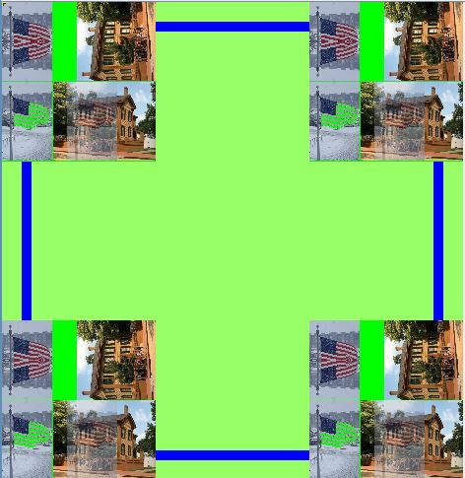
Part2
subFn2
Copying F1OUT.JPG to each corner
F1OUT.JPG
Part2
mainFn()
subFn1
subFn2
subFn3
subFn4
F2OUT.JPG
Notes:
Sub function 2 is very simple too, just copying the F1out to each corner of the canvas.

Slide 12
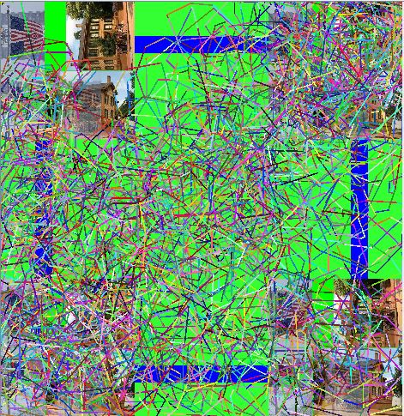
Part2
subfn3
Radom drawing
def subFn3(): #draw randomly on canvas
tr=Turtle(canvas2)
tr.setPenWidth(3)
for i in range(6000):
tr.setPenColor(makeColor(random.randint(1,255),random.randint(1,255),random.randint(1,255)))
tr.forward(int(100*random.random()))
tr.turn(int(90*random.random()))
F1OUT.JPG
Part2
mainFn()
subFn1
subFn2
subFn3
subFn4
F2OUT.JPG
Notes:
Sub function 3 I just used the codes from the example in our class, and it worked good.

Slide 13
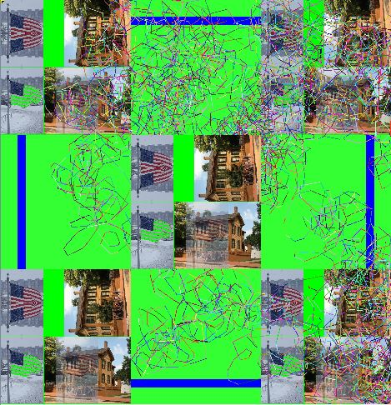
Part2
subFn4
Copying F1OUT.JPG to the center
F2OUT.JPG
F1OUT.JPG
Part2
mainFn()
subFn1
subFn2
subFn3
subFn4
F2OUT.JPG
Notes:
The last function, copying the f1out to the center of the canvas. It is very easy. Now this is my f2out.jpg. That all, we finished.

Slide 14
Thank You
Notes:
Thank you very much.

